Slide 1

STUDENT DETAILS
Name - Manish Parmar
SkillsBuild Email ID - parmarmanish4102@gmail.com
College Name - D Y Patil International University
College State - Maharashtra
Internship Domain - Data Analytics
Internship Start Date - 12/06/2023
Internship End Date - 24/07/2023

Slide 2
PROJECT TITLE/PROBLEM STATEMENT
ANALYSIS OF SAMPLE SUPERSTORE DATASET
“The management team of Sample Superstore, a retail establishment, desires to acquire erudition regarding their sales data to optimize their operations and ameliorate profitability. As such, they have proffered a dataset containing information concerning their customers, products, and transactions over a designated period. The aim of this undertaking is to scrutinize the dataset and extract consequential insights by performing sundry data analytics techniques and statistical analysis. The analysis ought to concentrate on identifying patterns, trends, and relationships within the data, as well as discerning factors that may impact sales and customer behavior. Furthermore, the project ought to encompass recommendations for the management team on potential strategies to augment sales, diminish costs, and enhance overall business performance predicated on the findings from the analysis.”

Slide 3
AGENDA
1. Introduction to the Sample Superstore Dataset: This section provides an overview of the dataset's structure and variables, as well as an understanding of the business context and objectives of the project.
2. Exploring and Cleaning the Data: This stage involves the identification of missing values, outliers, and inconsistencies in the dataset. The dataset is then cleaned by addressing these issues effectively.
3. Descriptive Analytics: This stage involves performing basic statistical analysis to summarize and describe the dataset. Relevant variables are analyzed by generating descriptive statistics such as mean, median, mode, standard deviation, etc. Additionally, charts, graphs, and histograms are employed to visualize data and gain initial insights.
4. Customer Segmentation: This stage involves conducting customer segmentation based on various customer attributes, including demographics and purchase behavior. Clustering algorithms such as K-means clustering are applied to identify distinct customer segments.The characteristics and preferences of each segment are further analyzed.
5. Sales Analysis, Profitability Analysis and Customer Behavior Analysis: This stage involves analyzing sales trends over time (e.g., monthly, quarterly, yearly) to identify patterns and seasonality.Additionally, the performance of different product categories and sub-categories is examined. The correlation between sales and other factors (e.g., region, customer segment, etc.) is also investigated. This stage involves calculating profit margins for different products and product categories. The most profitable and least profitable products are identified, and the impact of discounts, shipping costs, and other factors on profitability is analyzed. This stage involves examining customer purchasing patterns, including frequency, recency, and monetary value. Customer loyalty and retention rates are analyzed, and factors influencing customer churn are investigated to identify potential strategies for customer retention.
8. Recommendations and Insights: This stage involves summarizing the key findings and insights from the analysis. Actionable recommendations are provided to improve sales, profitability, and customer satisfaction. The results are presented in a clear and concise manner using visualizations and data-driven insights.
9. Conclusion: This section concludes the analysis project and summarizes the key takeaways. The limitations of the analysis are reflected upon, and potential areas for further exploration are identified.

Slide 4
PROJECT OVERVIEW
The present project, namely the Analysis of Sample Superstore Dataset, endeavors to exploit data analytics techniques to obtain insights into the sales data of Sample Superstore, a retail organization. The project entails scrutinizing a given dataset that encompasses information about customers, products, and transactions over a specific period. The fundamental objectives of the project can be enumerated as follows:
1. Data Exploration and Cleaning: The exploration of the dataset with an aim to comprehend its structure and variables. Identification and management of missing values, outliers, and inconsistencies. Preparation of the dataset for further analysis.
2. Descriptive Analytics: The execution of basic statistical analysis to summarize and describe the dataset. The generation of descriptive statistics, including mean, median, mode, and standard deviation, for pertinent variables. The visualization of data through charts, graphs, and histograms to acquire preliminary insights.
3. Customer Segmentation: The segmentation of customers on the basis of diverse customer attributes, such as demographics and purchase behavior.The application of clustering algorithms (e.g., K-means clustering) to recognize distinct customer segments. The analysis of the features and preferences of each segment.
4. Sales Analysis, Profitability Analysis and Customer Behavior Analysis: The analysis of sales trends over time (e.g., monthly, quarterly, yearly) to identify patterns and seasonality. An examination of the performance of various product categories and sub-categories. The investigation of the correlation between sales and other factors, such as region and customer segment. The calculation of profit margins for different products and product categories. The identification of the most profitable and least profitable products. The analysis of the impact of discounts, shipping costs, and other factors on profitability. The examination of customer purchasing patterns, including frequency, recency, and monetary value. An analysis of customer loyalty and retention rates. The investigation of factors influencing customer churn and the identification of potential strategies for customer retention.
5. Recommendations and Insights: The summarization of the key findings and insights from the analysis. The provision of actionable recommendations to enhance sales, profitability, and customer satisfaction. The presentation of the results in a clear and concise manner using data-driven insights and visualizations.

Slide 5
WHO ARE THE END USERS OF THIS PROJECT?
The Analysis of Sample Superstore Dataset project caters to a broad range of stakeholders within the Sample Superstore company. These stakeholders encompass the management team, business analysts, marketing team, sales team, operations team, finance team, and data analysts/scientists.
1. Management Team: The primary aim of the project's analysis and insights is to furnish the management team with indispensable information that they can utilize to make strategic decisions and implement changes to improve the company's operations, sales, and profitability.
2. Business Analysts: The business analysts, on the other hand, can use the project results to obtain a deeper understanding of customer behavior, product performance, and sales trends. They can further analyze the insights and incorporate them into their reports and recommendations.
3. Marketing Team: Moreover, the marketing team can leverage the project's findings to develop targeted marketing strategies based on customer segmentation and preferences. The analysis can also assist them in identifying potential customer segments to focus on and tailor marketing campaigns accordingly.
4. Sales Team: Similarly, the sales team can optimize its sales approach by understanding sales trends, product performance, and customer behavior, thereby adapting their strategies to better meet customer demands and increase sales revenue.
5. Operations Team: Furthermore, the operations team can utilize the project's recommendations to streamline processes, improve inventory management, and optimize supply chain operations. Based on the analysis of product categories, profitability, and customer satisfaction, they can identify areas of improvement.
6. Finance Team: The finance team can also benefit from the project's analysis of profitability and cost factors. The insights can help them identify cost-saving opportunities, evaluate the impact of discounts and shipping costs, and optimize pricing strategies.
7. Data Analysts/Scientists: Lastly, data analysts or data scientists within the organization can use the project as a reference for similar analyses and as a benchmark for future data-driven projects. They can also contribute their expertise in analyzing the dataset and extracting insights.

Slide 6
YOUR SOLUTION AND ITS VALUE PROPOSITION
Solution:
Our proposed solution for the project of Analyzing the Sample Superstore Dataset involves the application of advanced data analytics techniques to extract valuable insights from the provided dataset. Through comprehensive exploration, cleaning, and analysis of the data, our objective is to uncover patterns, trends, and relationships therein. The project comprises key components such as customer segmentation, sales analysis, profitability analysis, and customer behavior analysis.
Value Proposition:
Our analysis provides actionable insights to the management team of Sample Superstore, enabling them to make informed decisions based on data. Our findings aid in identifying areas of improvement, optimizing operations, and enhancing profitability. By understanding customer behavior, sales trends, and product performance, our analysis facilitates the development of targeted marketing strategies and sales approaches, leading to increased sales revenue and improved customer satisfaction. Additionally, our profitability analysis highlights the most and least profitable products and identifies factors impacting profitability, empowering the management team to optimize pricing, manage discounts, and streamline operations for cost savings.
Our project equips business analysts and stakeholders with a comprehensive understanding of the dataset, enabling them to make informed decisions. The insights gained from our analysis can be used as a benchmark for future data-driven projects. By leveraging data analytics techniques, Sample Superstore gains a competitive edge in the retail industry. Our recommendations and insights help the company to identify market trends, customer preferences, and potential growth opportunities, providing a competitive advantage. Furthermore, our analysis provides valuable insights for the operations team, facilitating optimized inventory management, supply chain operations, and overall operational efficiency.
Our solution is scalable and adaptable to accommodate additional datasets, variables, and analysis requirements, allowing Sample Superstore to leverage data analytics for ongoing improvement and growth.

Slide 7
HOW DID YOU CUSTOMIZE THE PROJECT AND MAKE IT YOUR OWN
1. Upon reviewing the initial project objectives, I shall take into account additional goals or specific areas of focus that are aligned with my expertise or interests to personalize the project objectives.
2. In the event that suggested analysis techniques are incorporated into the project, I shall utilize my knowledge of advanced analytics methods or specialized statistical models to provide more profound insights. This may involve the integration of predictive modeling, time series analysis, or sentiment analysis to create more precise predictions or actionable recommendations.
3. To present the analysis findings in a visually appealing and easily understandable manner, I may explore innovative data visualization techniques beyond the typical charts and graphs. This could involve the use of interactive dashboards, storytelling techniques, or infographics to captivate stakeholders and convey insights effectively.
4. Utilizing my domain knowledge or prior experience, I shall provide context-specific insights that surpass basic analysis.
5. Although recommendations are a pivotal aspect of the project, I shall ensure that they are practical and actionable. This may involve providing specific implementation strategies such as launching loyalty programs, optimizing pricing structures, or improving inventory management, to support the management team in executing the recommended changes.
6. I shall infuse my personal style into the project by using clear and concise language, incorporating effective storytelling techniques, and presenting the analysis results in a visually appealing and engaging format.

Slide 8
MODELLING
1. The utilization of clustering algorithms such as K-means, hierarchical clustering, or DBSCAN can be applied in the customer segmentation modeling to segment customers based on their attributes, behavior, or purchasing patterns. By adopting this modeling technique, one can identify distinct customer groups and comprehend their unique characteristics.
2. Predictive modeling can be established to forecast sales, demand, or customer behavior. Techniques such as regression analysis, time series analysis, or machine learning algorithms like linear regression, random forests, or gradient boosting can be implemented to predict future outcomes based on historical data.
3. Association rule mining techniques such as Apriori or FP-Growth can be employed in the market basket analysis to identify frequent item-sets and reveal relationships between products frequently purchased together. This modeling approach can facilitate cross-selling or product recommendation strategies.
4. Models can be developed to predict customer churn or attrition through the application of classification algorithms like logistic regression, decision trees, or support vector machines to determine factors that contribute to customer churn and create targeted retention strategies.
5. Collaborative filtering or content-based filtering techniques can be utilized in recommendation systems to suggest relevant products to customers based on their preferences, purchase history, or similar customer behavior.
6. Natural language processing (NLP) techniques can be applied in sentiment analysis to analyze customer reviews, feedback, or social media data. Sentiment analysis models can be utilized to gauge customer sentiment, identify trends, and comprehend customer opinions about products or services.
7. Mathematical optimization techniques like linear programming, integer programming, or network optimization can be utilized in optimization modeling to optimize inventory levels, pricing strategies, or supply chain operations. This modeling approach can help in maximizing profits or minimizing costs.

Slide 9
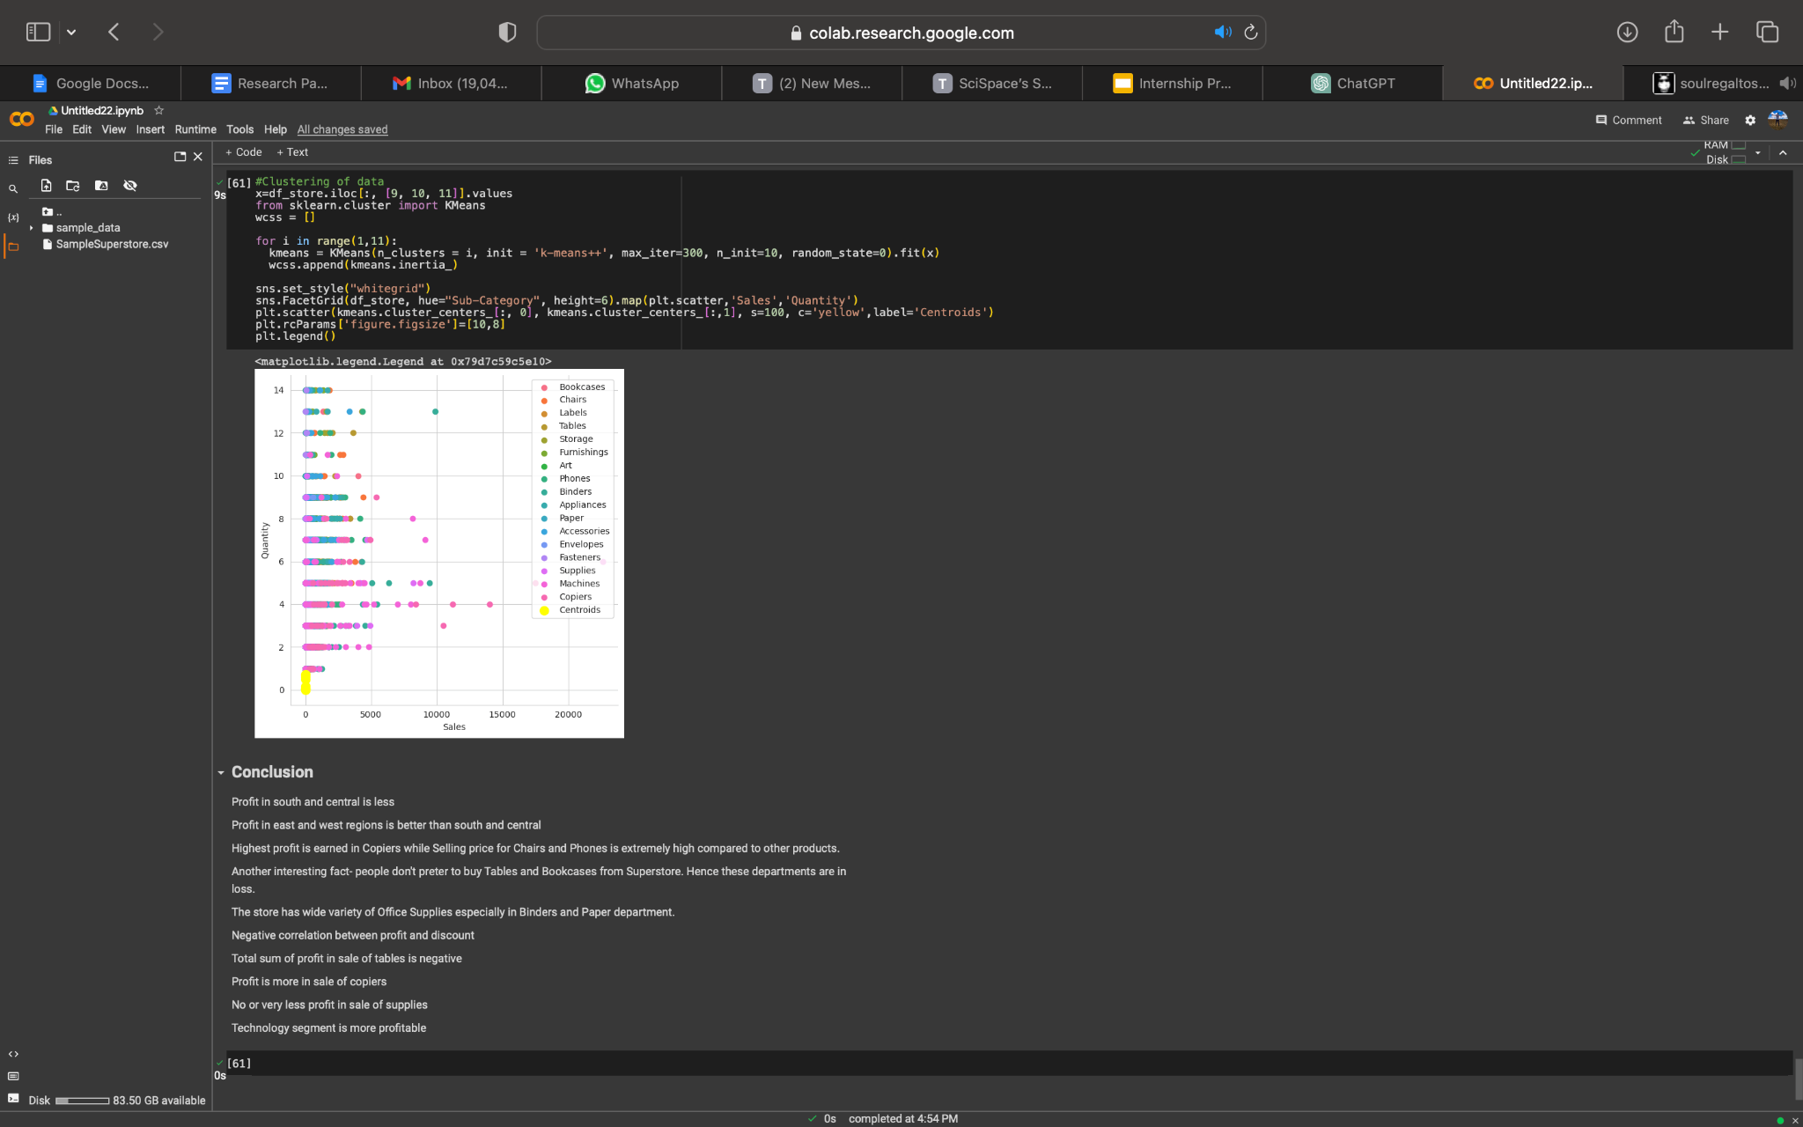
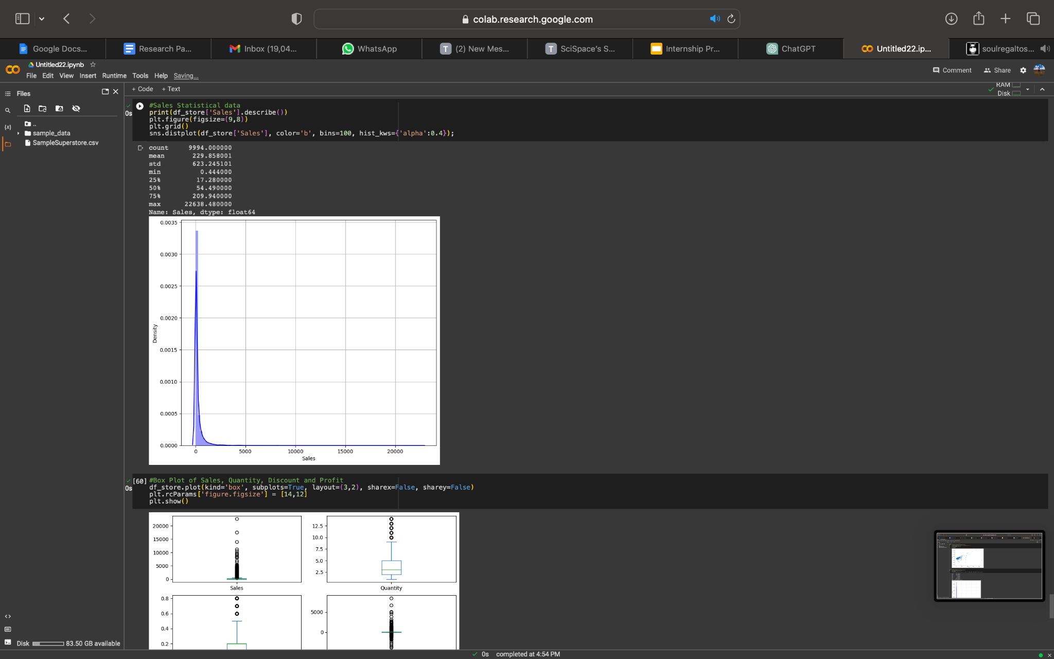
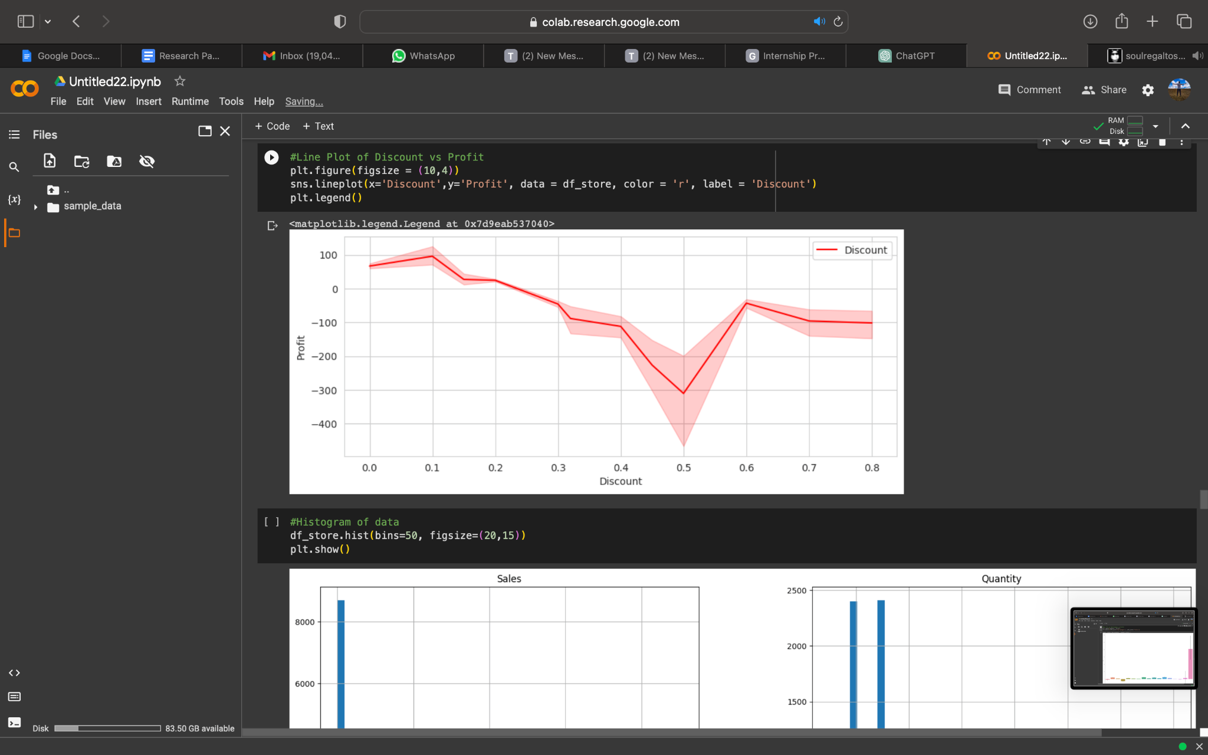
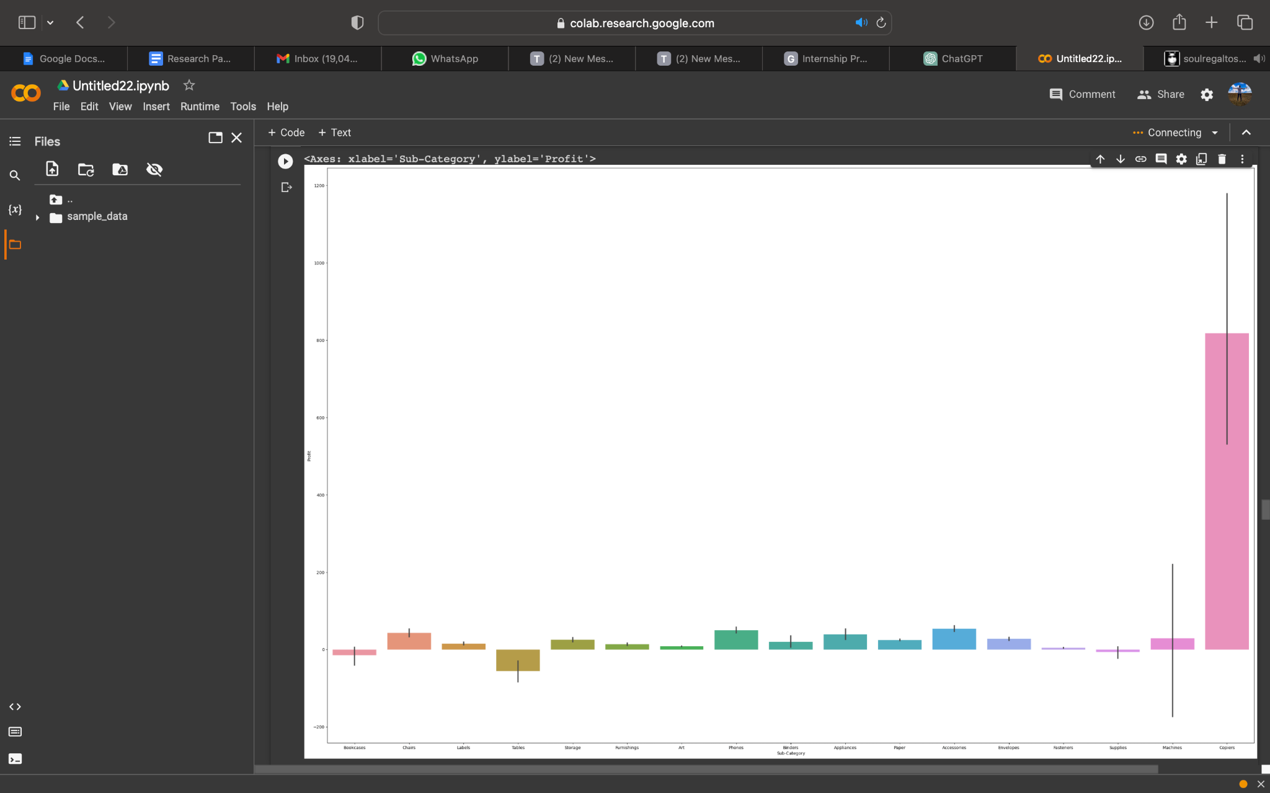
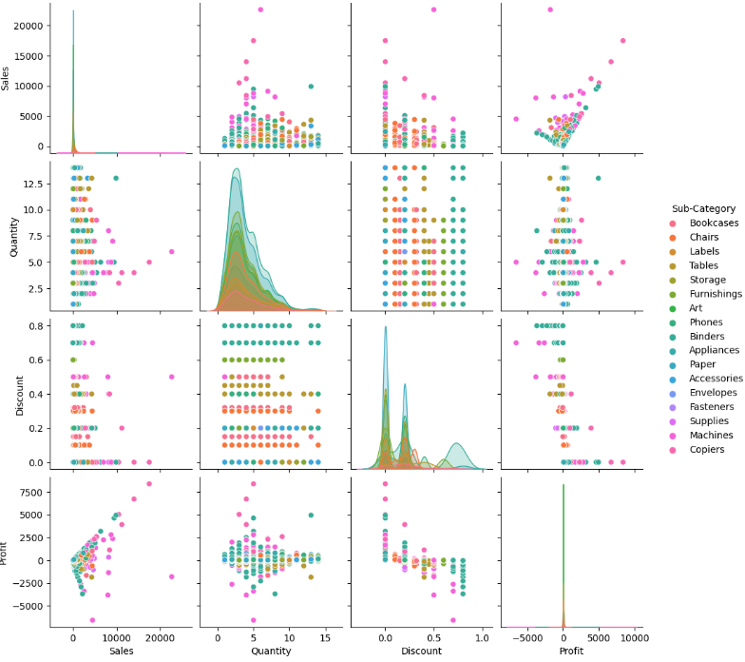
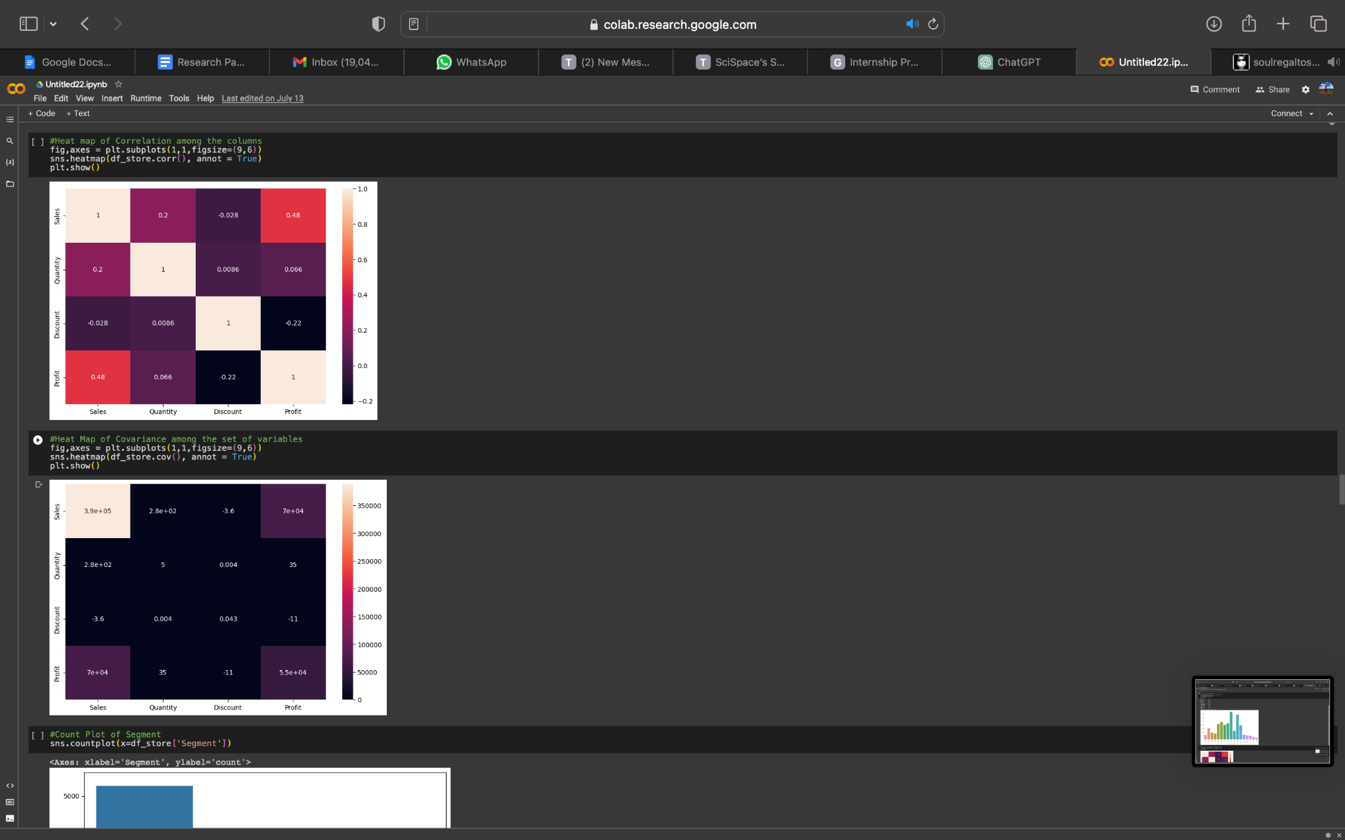
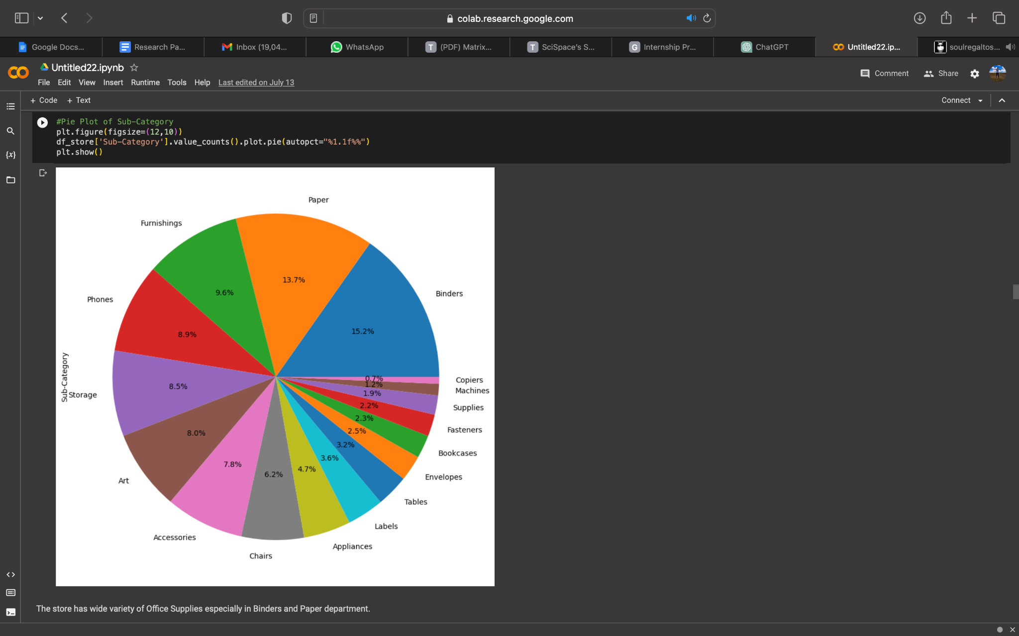
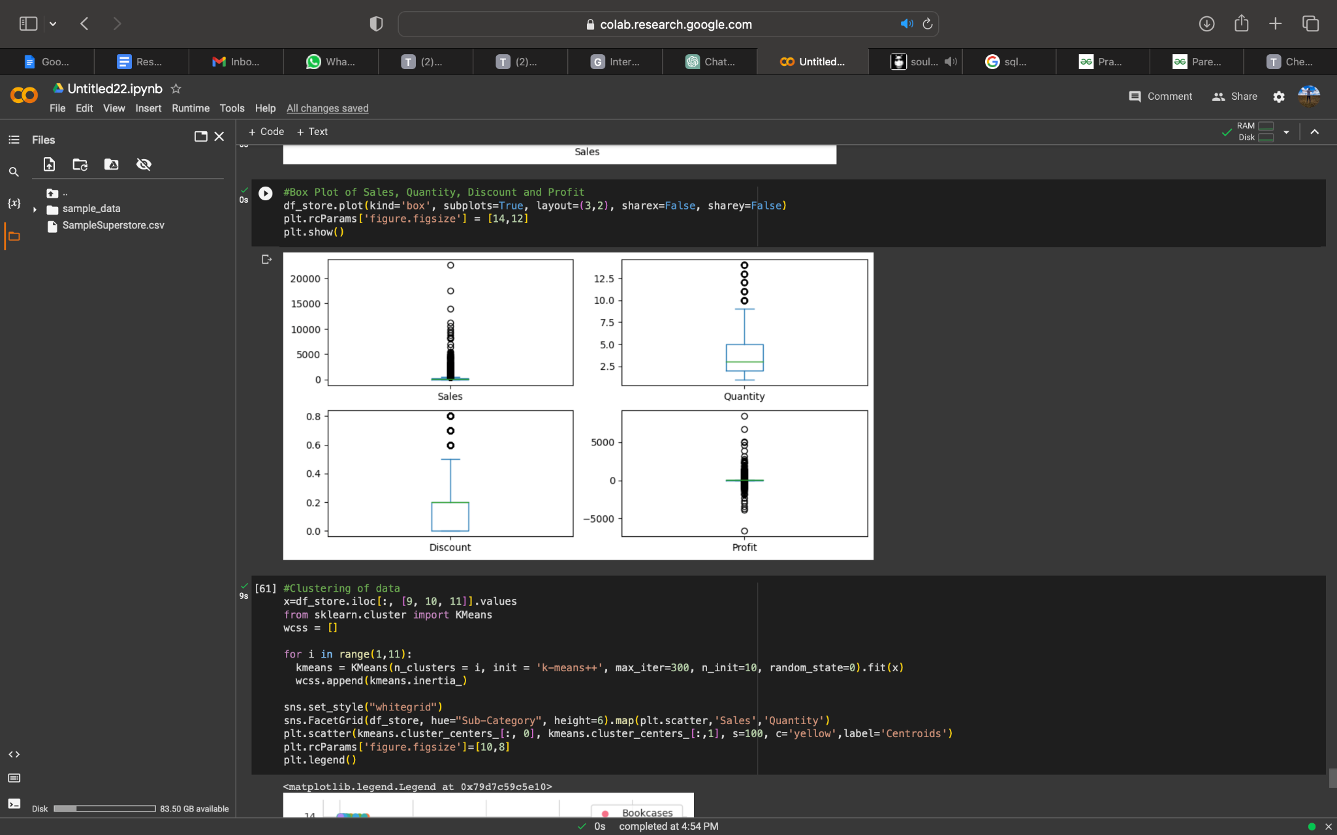
RESULTS

Slide 10
DATASET
Dataset URL:
https://www.kaggle.com/datasets/bravehart101/sample-supermarket-dataset
About the dataset: The dataset provides information about the sales and profit from a supermarket.
Dataset Details:
Column Names:
['Ship Mode', 'Segment', 'Country', 'City', 'State', 'Postal Code',
'Region', 'Category', 'Sub-Category', 'Sales', 'Quantity', 'Discount',
'Profit']
Size | 167kb
Number of Columns | 13
Number of Rows | 9994
Original file format | Csv

Slide 11
Data Cleaning and Exploring the data
Category, Sub-Category and Segments types in data:
df_store["Category"].unique()
df_store["Sub-Category"].unique()
df_store["Segment"].unique()
Dropping of Postal Code Column because Postal Code doesn't have any impact on the profit and doesn't give any actionable insights:
df_store = df_store.drop(columns=["Postal Code"], axis=1)
Total number of null values in data:
df_store.isnull().sum()
Unique data in each column:
for col in df_store:
print(df_store[col].unique())
Dropping of duplicate values:
df_store.drop_duplicates()
Full summary of data:
df_store.info()
Number of products in each sub-category and category:
df_store["Sub-Category"].value_counts()
df_store["Category"].value_counts()

Slide 12
Statistical Summary of the Data
Understanding the distribution of the data: The mean, min, max, and other metrics provide a quick overview of the distribution of the data. Outlier detection:
The min, 25%, 75%, and max values can help identify outliers in the data.
Data normalization: The mean and std values can be used to normalize the data.
Feature scaling: The min, max, and other values can be used to scale the features to a suitable range.
df.describe()
 | Sales | Quantity | Discount | Profit
count | 9994.000000 | 9994.000000 | 9994.000000 | 9994.000000
mean | 229.858001 | 3.789574 | 0.156203 | 28.656896
std | 623.245101 | 2.225110 | 0.206452 | 234.260108
min | 0.444000 | 1.000000 | 0.000000 | -6599.978000
25% | 17.280000 | 2.000000 | 0.000000 | 1.728750
50% | 54.490000 | 3.000000 | 0.200000 | 8.666500
75% | 209.940000 | 5.000000 | 0.200000 | 29.364000
max | 22638.480000 | 14.000000 | 0.800000 | 8399.976000

Slide 13
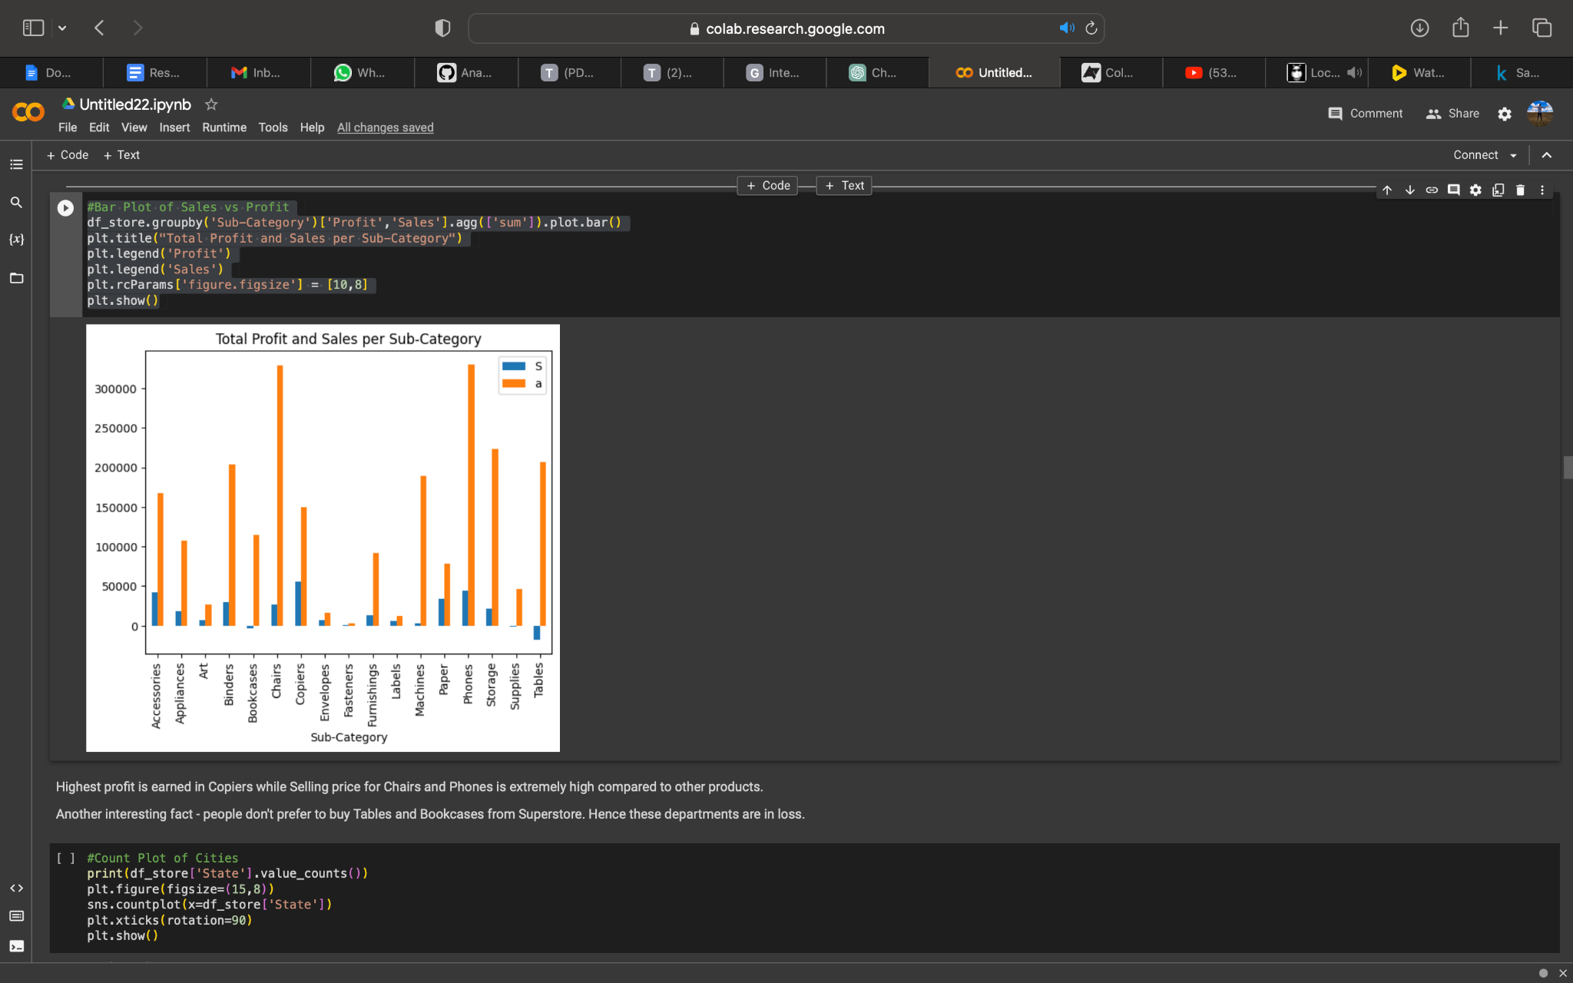
Exploratory Data Analysis - EDA
Pie Plot of Sub-Category:
plt.figure(figsize=(12,10))
df_store['Sub-Category'].value_counts().plot.pie(autopct="%1.1f%%")
plt.show()
Bar Plot of Sales vs Profit:
df_store.groupby('Sub-Category')['Profit','Sales'].agg(['sum']).plot.bar()
plt.title("Total Profit and Sales per Sub-Category")
plt.legend('Profit')
plt.legend('Sales')
plt.rcParams['figure.figsize'] = [10,8]
plt.show()

Slide 14
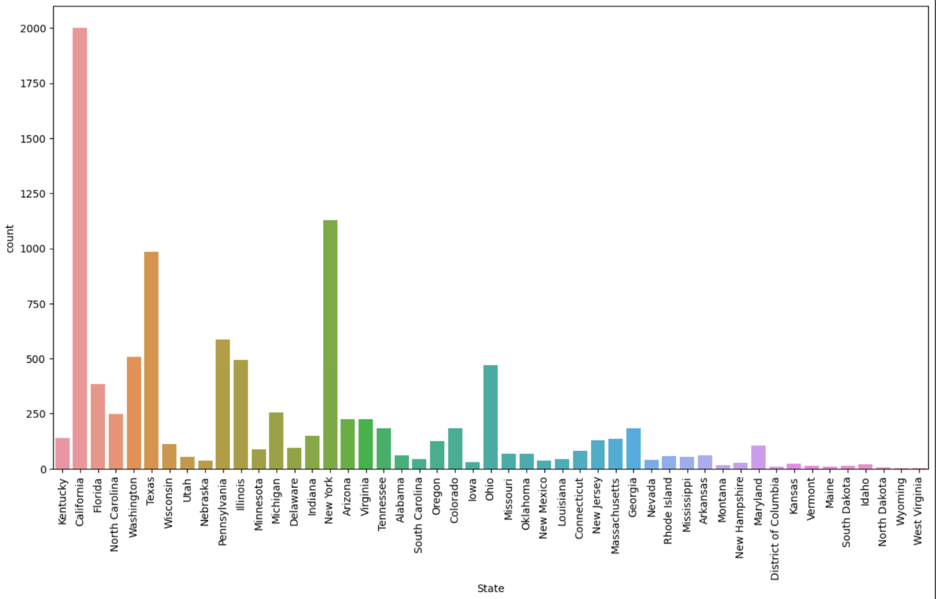
Count Plot of Cities:
print(df_store['State'].value_counts())
plt.figure(figsize=(15,8))
sns.countplot(x=df_store['State'])
plt.xticks(rotation=90)
plt.show()
Heat map of Correlation among the columns:
fig,axes = plt.subplots(1,1,figsize=(9,6))
sns.heatmap(df_store.corr(), annot = True)
plt.show()

Slide 15
Bar Plot of Sub-Category vs Profit:
plt.figure(figsize = (25,25))
sns.barplot(x=df_store['Sub-Category'], y=df_store['Profit'])
Line Plot of Discount vs Profit:
plt.figure(figsize = (10,4))
sns.lineplot(x='Discount',y='Profit', data = df_store, color = 'r', label = 'Discount')
plt.legend()

Slide 16
Pair Plot of Sub-Category:
figsize = (15,10)
sns.pairplot(df_store, hue='Sub-Category')
Sales Statistical data:
print(df_store['Sales'].describe())
plt.figure(figsize=(9,8))
plt.grid()
sns.distplot(df_store['Sales'], color='b', bins=100, hist_kws={'alpha':0.4});

Slide 17
Box Plot of Sales, Quantity, Discount and Profit:
df_store.plot(kind='box', subplots=True, layout=(3,2), sharex=False, sharey=False)
plt.rcParams['figure.figsize'] = [14,12]
plt.show()
Clustering of data:
x=df_store.iloc[:, [9, 10, 11]].values
from sklearn.cluster import KMeans
wcss = []
for i in range(1,11):
kmeans = KMeans(n_clusters = i, init = 'k-means++', max_iter=300, n_init=10, random_state=0).fit(x)
wcss.append(kmeans.inertia_)
sns.set_style("whitegrid")
sns.FacetGrid(df_store, hue="Sub-Category", height=6).map(plt.scatter,'Sales','Quantity')
plt.scatter(kmeans.cluster_centers_[:, 0], kmeans.cluster_centers_[:,1], s=100, c='yellow',label='Centroids')
plt.rcParams['figure.figsize']=[10,8]
plt.legend()

Slide 18
RESULTS
1. The outcomes of customer segmentation analysis have yielded results that showcase the identification of distinct customer segments based on demographics, purchasing behavior, or geographic location. Furthermore, the characteristics and preferences of each customer segment have been carefully analyzed, including high-value customers, frequent purchasers, or price-sensitive customers.
2. The sales analysis results have been carefully analyzed by identifying sales trends over time (monthly, quarterly, yearly), peak seasons or periods of high demand, as well as the performance of different product categories. Additionally, the top-selling and underperforming products have also been identified, while correlations between sales and factors such as region, customer segment, or product attributes have been explored.
3. The outcomes of the profitability analysis have been calculated by determining profit margins for different products and product categories to identify the most profitable and least profitable items. Furthermore, the impact of discounts, shipping costs, or other factors on profitability has been carefully analyzed. The identification of opportunities to optimize pricing strategies, reduce costs, or improve overall profitability has also been carefully noted.
4. The results of customer behavior analysis showcase the careful analysis of customer purchasing patterns, such as frequency, recency, and monetary value, to understand customer loyalty and lifetime value. The factors that influence customer churn have also been identified, and strategies for customer retention have been developed. Cross-selling and upselling opportunities based on market basket analysis and product association have also been explored.
5. The recommendations and insights have been provided based on actionable recommendations to improve sales, profitability, and customer satisfaction, based on the analysis results. Strategies for targeted marketing campaigns, product promotions, or customer retention initiatives have been proposed. Furthermore, potential areas for process optimization, inventory management, or supply chain efficiency improvements have also been highlighted.

Slide 19
CONCLUSION
1. Profit margins are lower in the south and central regions. In contrast, the east and west regions have higher profit margins.
2. Copiers are the most profitable product, with Chairs and Phones having an exceptionally high selling price in comparison to other products. Tables and Bookcases have lower sales, resulting in a loss in those departments.
3. The store offers a wide selection of office supplies, with a particular emphasis on Binders and Paper.
4. There exists a negative correlation between profit and discount. The total profit from the sale of tables is negative, while copiers yield higher profits. Supplies, on the other hand, yield little to no profit.
5. The technology segment is comparatively more profitable than other segments.
6. Sales numbers indicate that the west region has the highest sales volume, followed by the east, central, and south regions.Profit margins are lower in the central region, as compared to the west region.
7. Copiers are the most profitable product, with Chairs and Phones having an exceptionally high selling price in comparison to other products. Tables and Bookcases have lower sales, resulting in a loss in those departments.
8. The store offers a wide selection of office supplies, with a particular emphasis on Binders and Paper.
9. The frequency of individual items in the furniture category is low. In contrast, the frequency of individual items in the office supplies category is moderate, and high in the technology category.

Slide 20
LINKS
Google Colab:
https://colab.research.google.com/drive/178d5cy-NYYglDib81Sqe3VSKHFRwKNpe?usp=sharing
GitHub Repository:
https://github.com/manish4102/IBM_Project_Sample_Superstore/blob/main/Sample_Superstore_IBM_Project.ipynb
Research Paper:
Here are some references for sales analysis on Superstore dataset:
•Chakraborty, M. (2020). Sales Analysis of Superstore using Power BI.Kaggle.
https://www.kaggle.com/moumoyesh/sales-analysis-of-superstore-using-powerbi
•Microsoft. (n.d.). Analyse and visualize Superstore data in Power BI.
https://powerbi.microsoft.com/en-us/tutorials/analyze-and-visualize-superstore-data/

